Slide 1
Wireless Remote PC Controller
University of California, Los Angeles
CSM117 Final Project Presentation
Zechang Li (504-065-429)
Yuxiao Xie (504-079-412)
Dec.6/2013

Slide 2

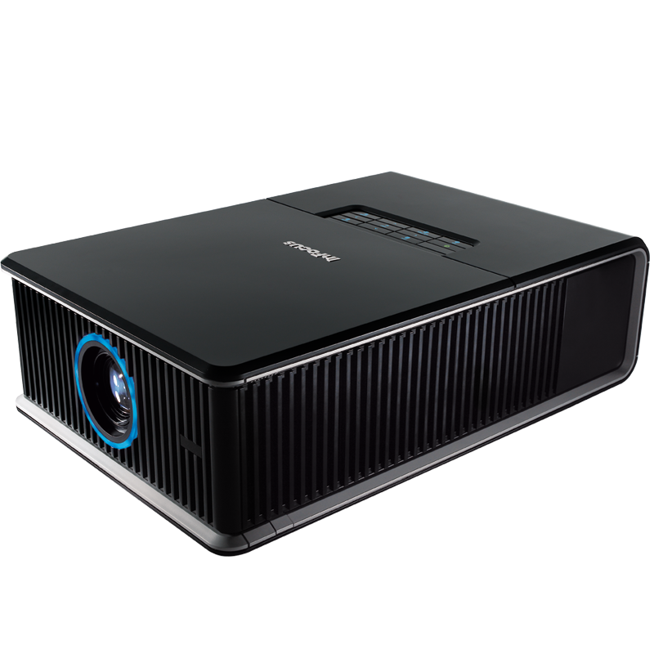
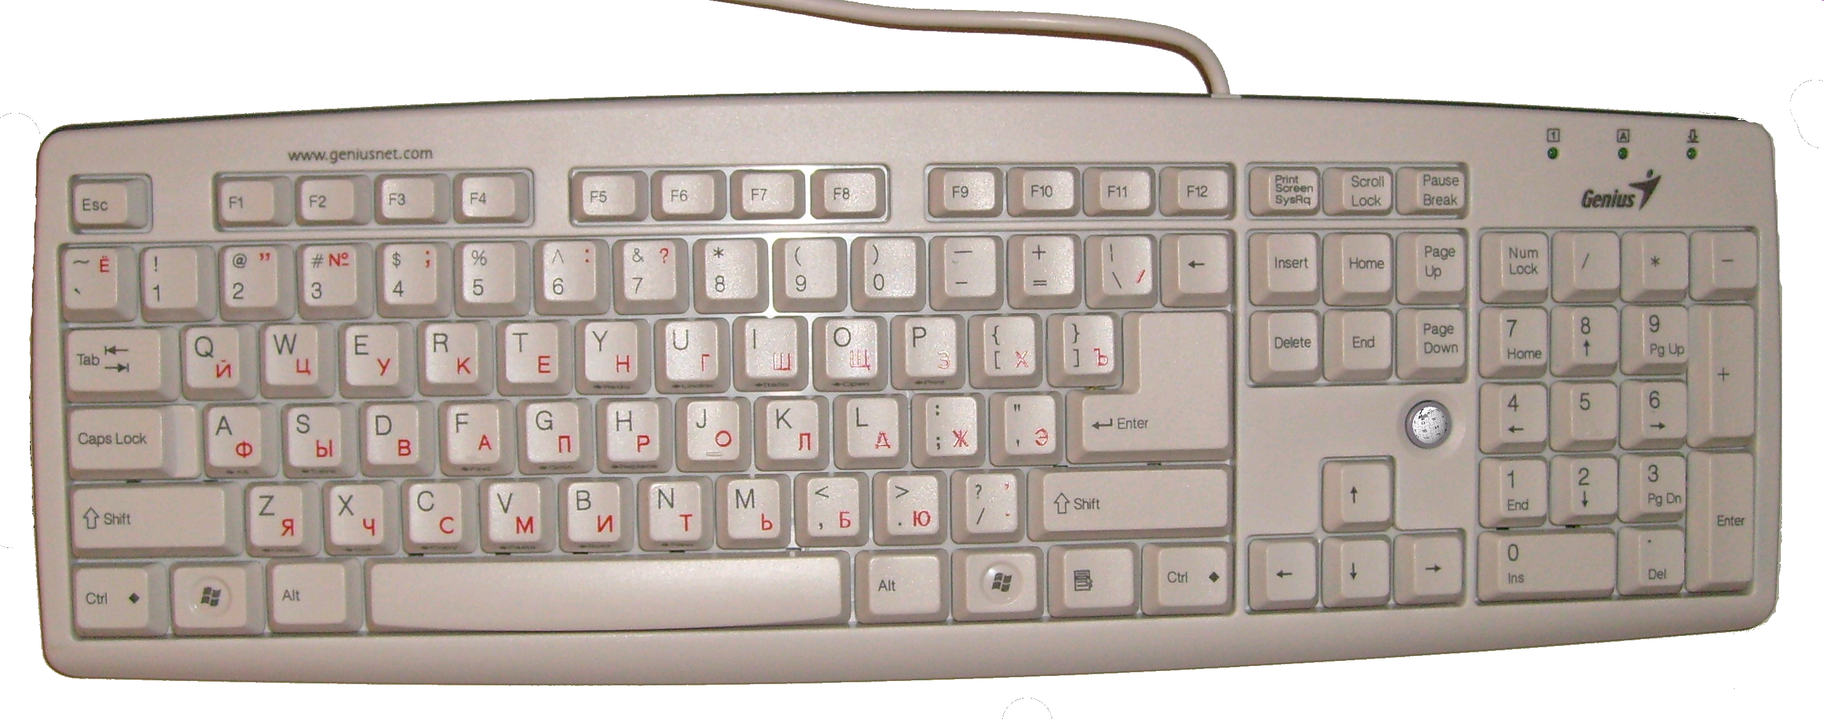
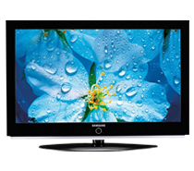
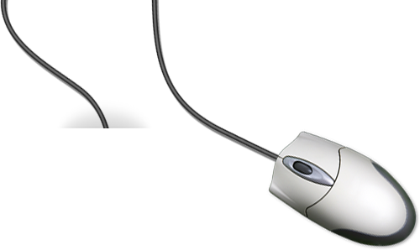
Introduction Initiative Idea
The output of PC varies, but input methods are still in old fashion
Cathode ray tube
LCD LED Projector

Slide 3
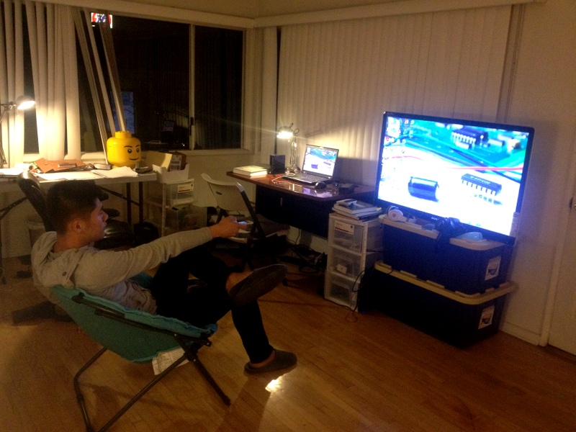
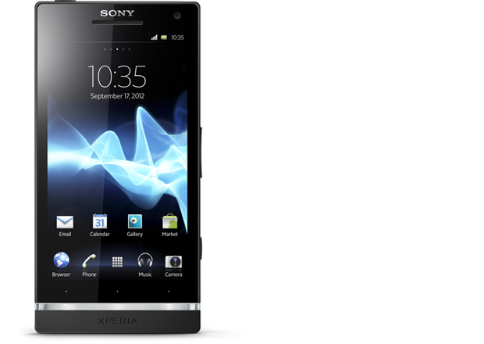
Introduction
How are we going to change it ??

Slide 4
Development Process
UI Design
Li
App Develop.
Xie & Li
Test & Modify
Xie
Photoshop
Android SDK

Slide 5
Project Structure
Router
Wi-Fi
UDP/TCP
Server
Data Process
Snd/Rcv Data
Client
Snd/Rcv Data

Slide 6
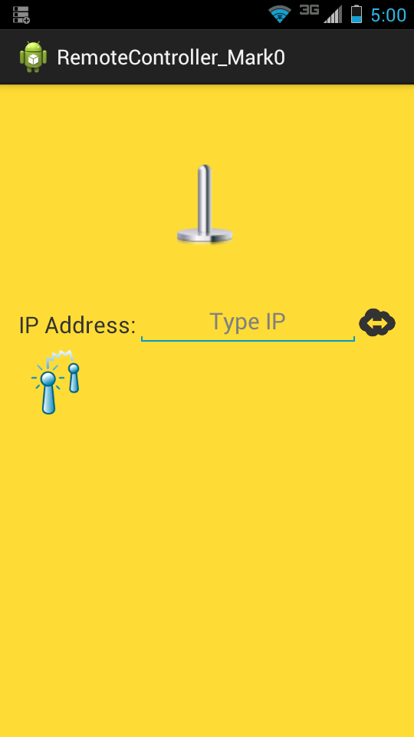
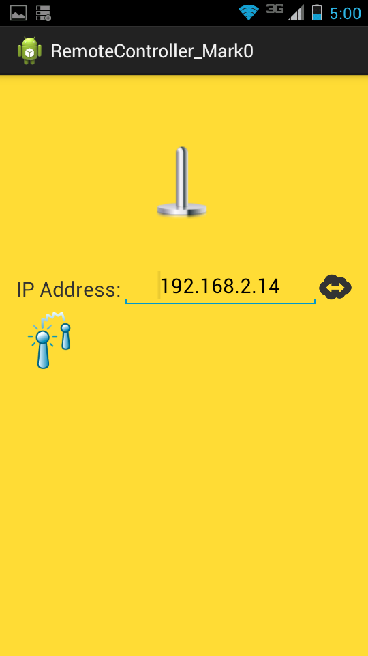
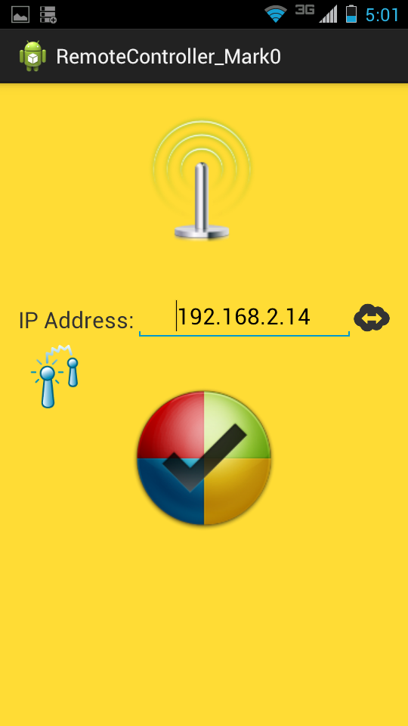
Application Function Making Connection

Slide 7
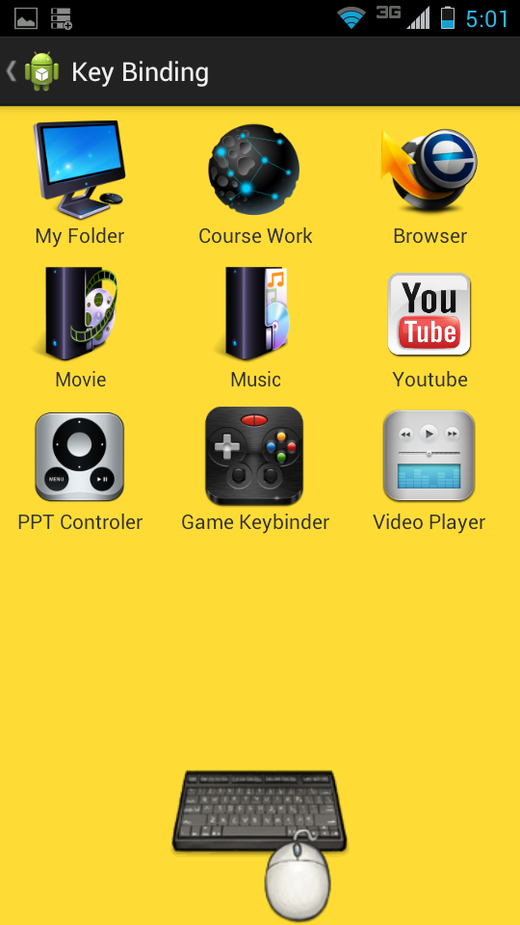
Application Function Main Menu
App/File Start Up
Make direct link to App/File
PPT Remote
Wireless Mouse/Keyboard
Insert/Delete Message to Server UI
Video/Music Remote

Slide 8
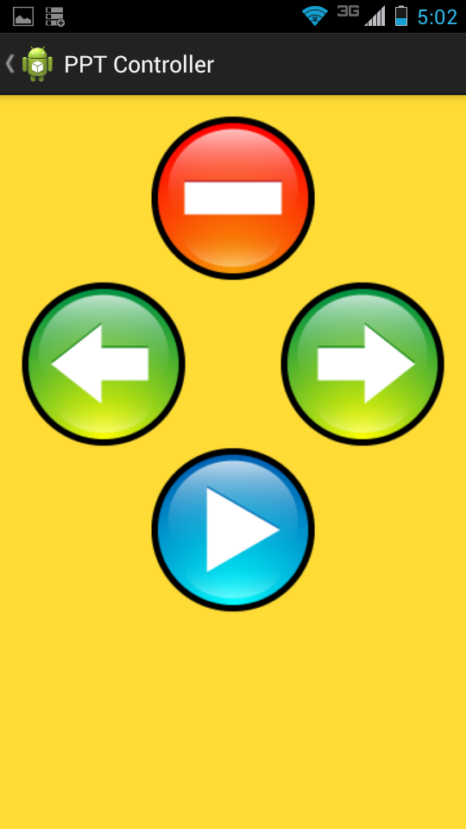
Application Function PPT Remote
PRV
END
START
NXT

Slide 9
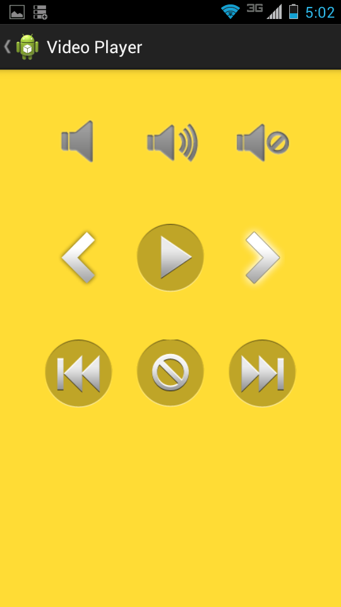
Application Function Video/Music Control

Slide 10
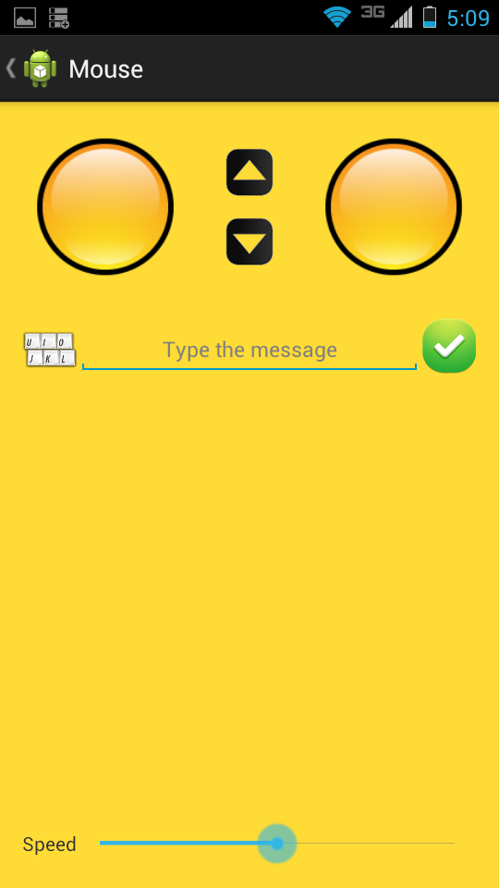
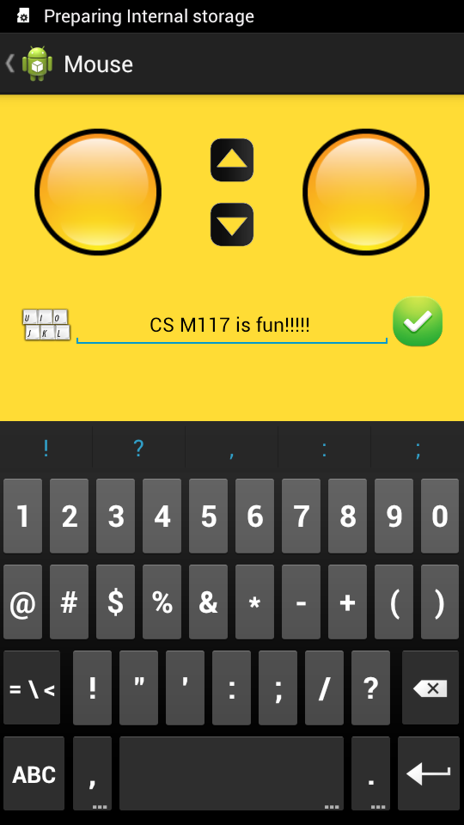
Application Function Cursor-TrackPad/Keyboard

Slide 11
Technicl Issuse
TCP vs. UDP
UDP: Cursor Tracker TCP: Everything else
Algorithm - java.awt.robot

Slide 12

Demo
http://www.youtube.com/watch?v=T0We591F9Vc
http://v.youku.com/v_show/id_XNjQ0NTIzOTM2.html

Slide 13
Later Development
User Controlled Server Software
UI Optimization

Slide 14
Thank You

